Slide 1

Interactive Storytelling Architecture for Training
Brian Magerko
Bob Wray
Additional project contributors:
Lisa Holt, Brian Stensrud

Slide 2
Motivation
Training systems often use “pre-canned” exercises
  Limited interest of student (poor motivation)
  Limited training value (slow learning curve)
Hypothesis:
  Improve both interest (engagement) and training effectiveness by inserting an intelligent controller (director) into virtual training systems
Intelligent tutoring in unstructured domains

Slide 3
ISAT
Based on work done with Interactive Drama Architecture (IDA)
  Director as scenario manager
  Author as trainer
Provides individualized training experience
  Trainee aptitude in skills
  Drama
Explores application of interactive storytelling techniques to training
Notes:
Focus on this being a design to be implemented, not an actual working system

Slide 4
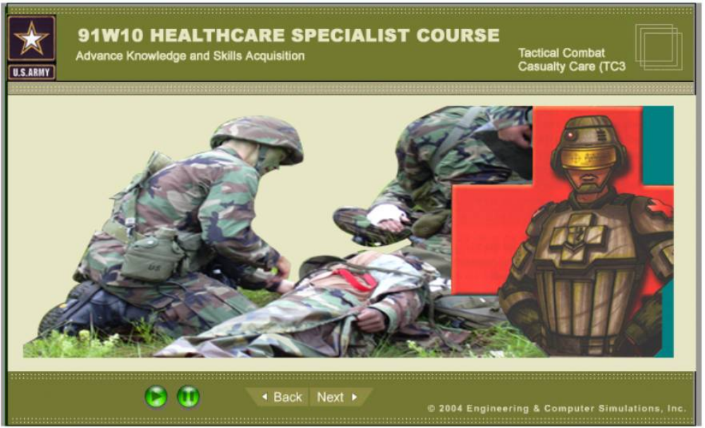
Environment

Slide 5
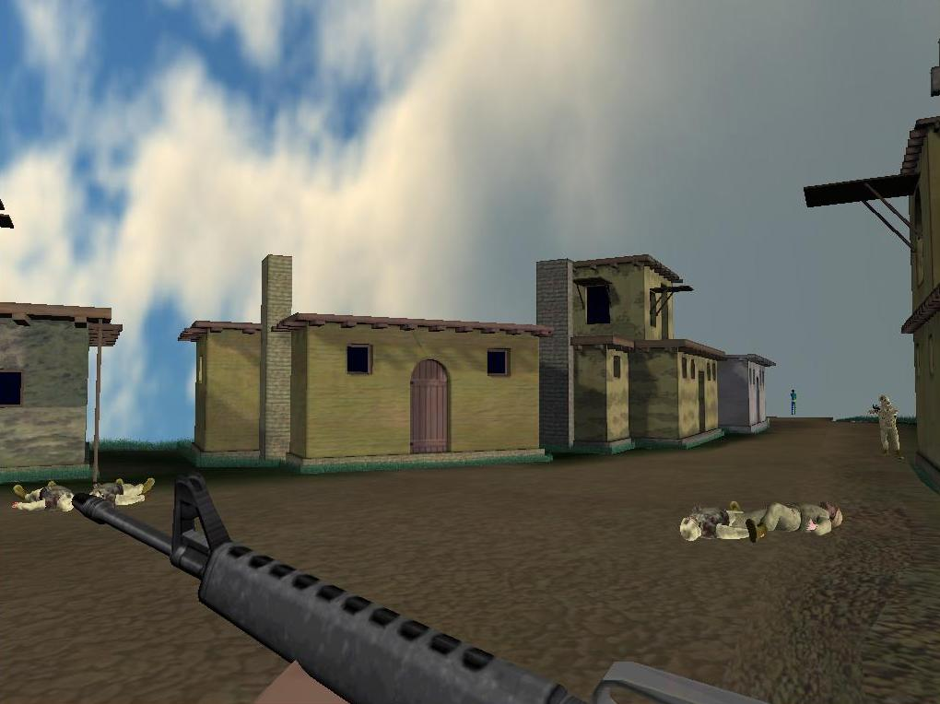

Slide 6
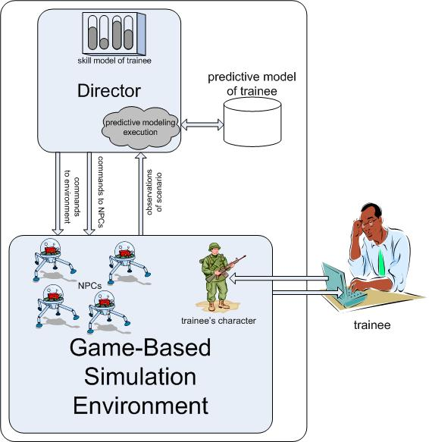
Architecture

Slide 7
Scenario representation
Scenario
  Partially-ordered abstract scenes
  Mapping between possible actions and skills
Scene
  Explicit list of skills tested
  Abstract events

Slide 8
Director Actions
Reactive & Predictive direction
  Similar to IDA
  React to trainee actions (provide feedback)
  Anticipate trainee actions and structure events to ensure desired outcomes
Skill-based direction
  Take actions that allow trainee to demonstrate skills
Heuristic scene choice & instantiation
  Decisions motivated by skills & narrative arc

Slide 9
Skill-based direction
Provide indirect environment feedback to trainee during task performance
  Constraints
    Maintain engagement: No “instructor popups”
    Provide guidance (scaffolding) but don’t make it a crutch (fading)
    Need multiple levels of intercession for the same trainee actions
  Direction based on f^{n} of recency, strength, decay, & ?? of skill
Example
  Trainee fails to check civilian casualty for booby traps
  Possible director actions:
    Blow up trainee, roll out dud grenade, CO yells, NOP

Slide 10
Skills in 91W TC3
Skills | Description
Care Under Fire | In a hot zone situation, return fire and help secure the area before attempting treatment or extraction.
Find Temporary Fighting positions | Minimize exposure to fire by staying low to ground and using objects in the environment.
Prioritize casualties | Decide the order in which patients should receive care.
Secure casualty | Make sure the casualty poses/can pose no threat.
Check vitals | Check casualty’s breathing, heart beat, and skin color.
Apply tourniquet | Decide when a casualty/situation requires a tourniquet and apply the tourniquet.
Manage airway | Open airway if the patient’s breathing is labored.
Manage chest wound | Take correct steps to treat a casualty with a chest wound.
Monitor | Monitor casualty until evacuation
Extraction | Properly extract a casualty from a hot zone.

Slide 11
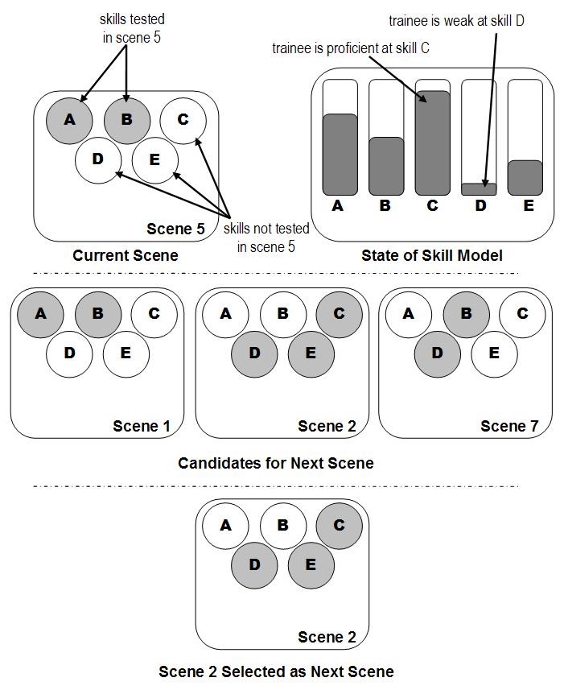
Heuristic Scene Choice

Slide 12
Scene instantiation
Skill model for content selection & refinement
  Instantiate scene to test specific skills
  Transition f^{n} from skills & content to complete scene
E.g. in “the ambush scene:”
  Trainee is untested in tourniquet skills
  → spawn an enemy on top of building with RPG

Slide 13
Next steps
Full implementation in 91W TC3
Research in robust predictive models
Diagrammatic authoring & debugging tool
Evaluation of approach & tools
Implementation in other environments

Slide 14
Nuggets and Coal
Nuggets
  Extended IDA to training domain
  New approach to teaching in unstructured, real-time domain
  Working prototype in 91W TC3 trainer
  Lots of interest (potential funders/customers!)
Coal
  Skill model is immature
  Scene representation & instantiation is immature
  Lack of other environments to show generalizability

Slide 15
Questions?
brian@magerko.org
wray@soartech.com

